Slide 1




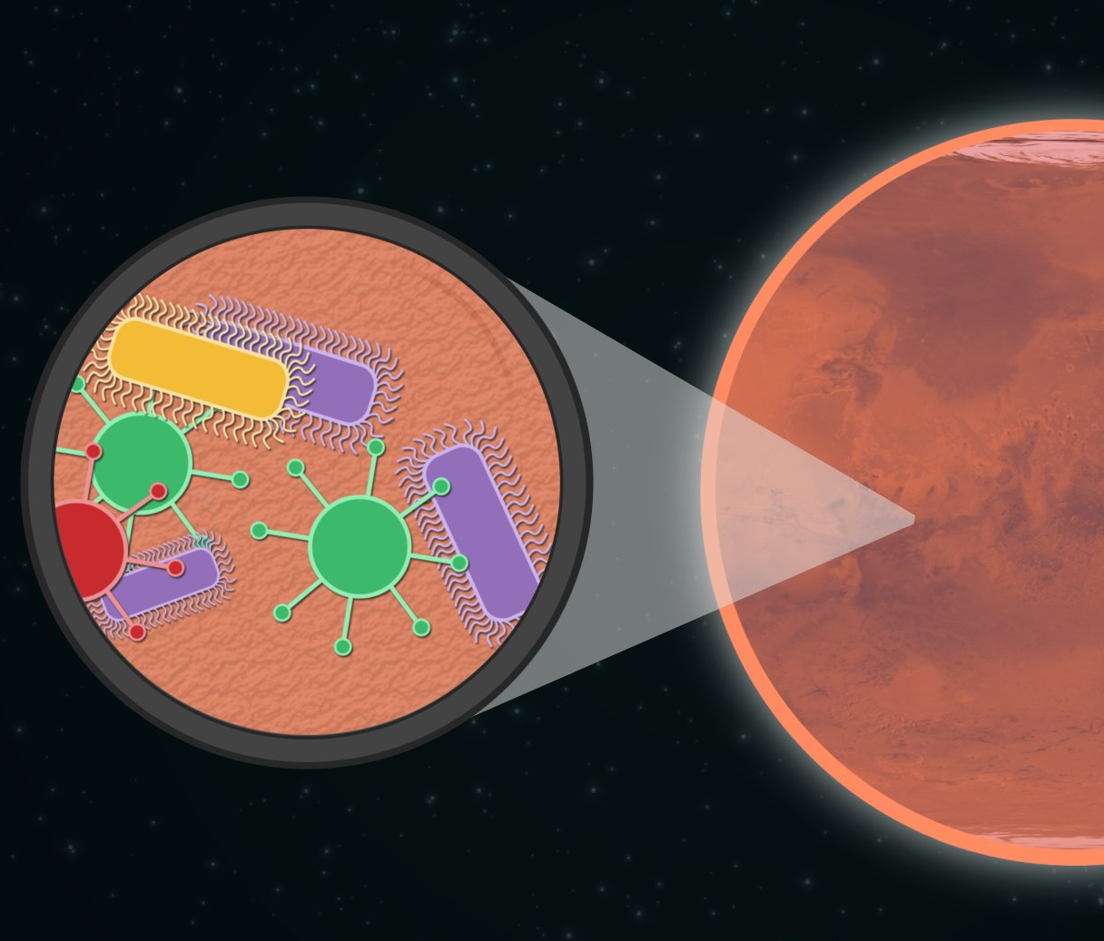
Mapping potential Life nest on Mars, using ArcgisPRO
TOUDJI Yanis
2020
RUDNed

Slide 2
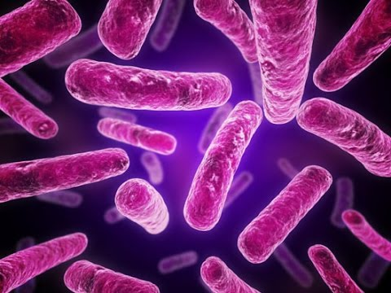
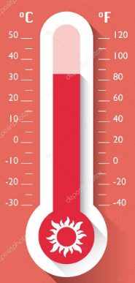
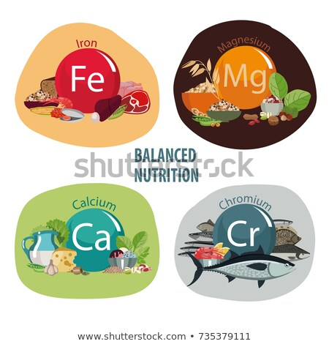

LIFE

Slide 3
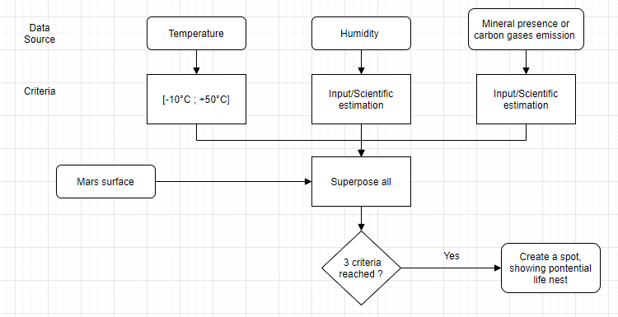
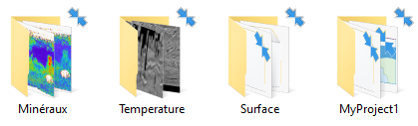
http://mars.asu.edu/data/

Slide 4
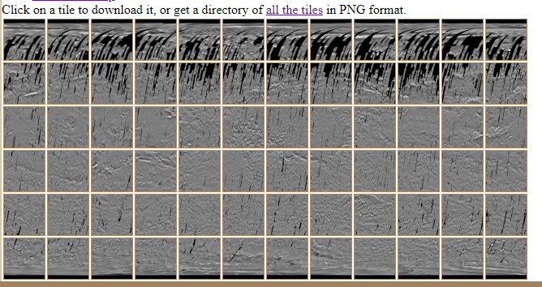
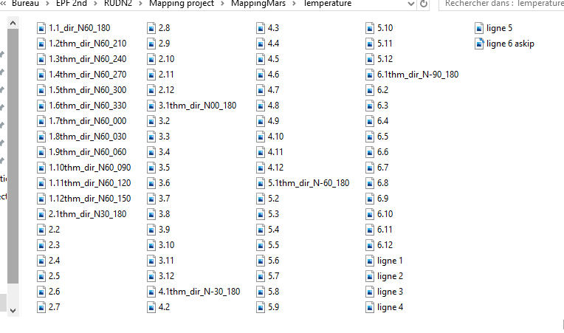
Temperature’s layer
72 files to merge together

Slide 5
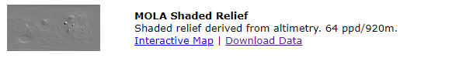
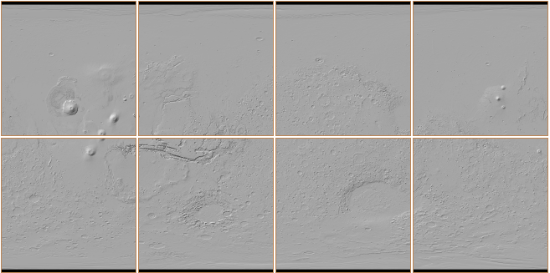
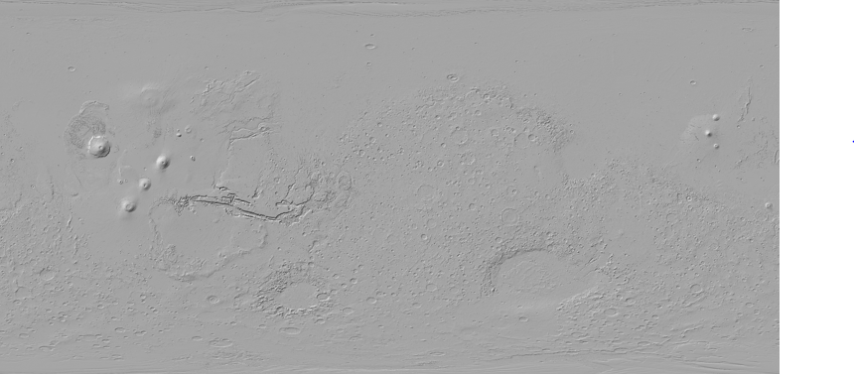
Surface’s layer

Slide 7
Life sustainability of minerals
SILICATES
FELDSPAR
PLAGIOCLASE
HEMATITE
OLIVINE
AMPHIBOL…

Slide 8
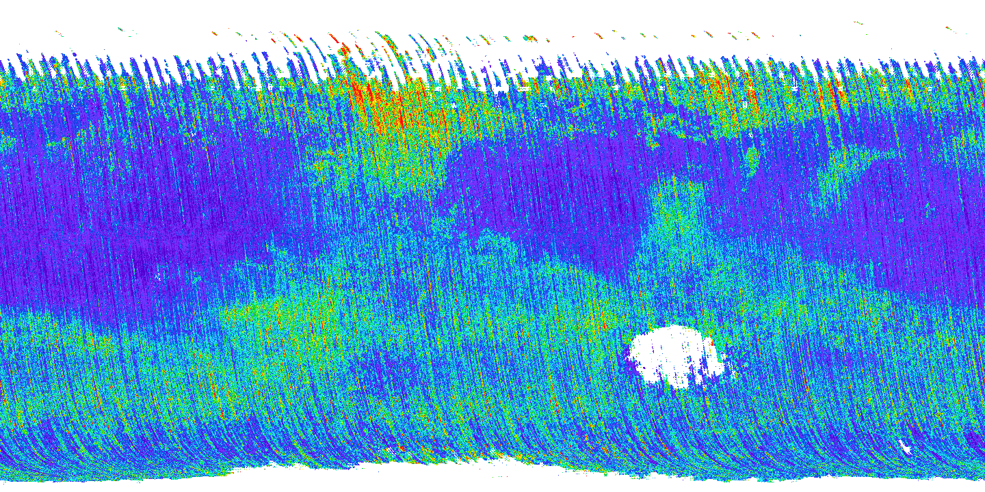
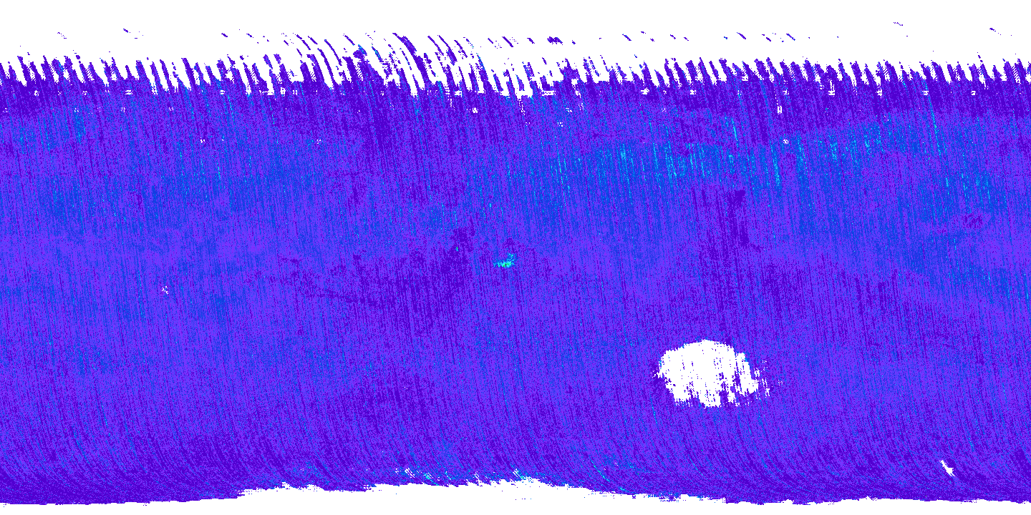
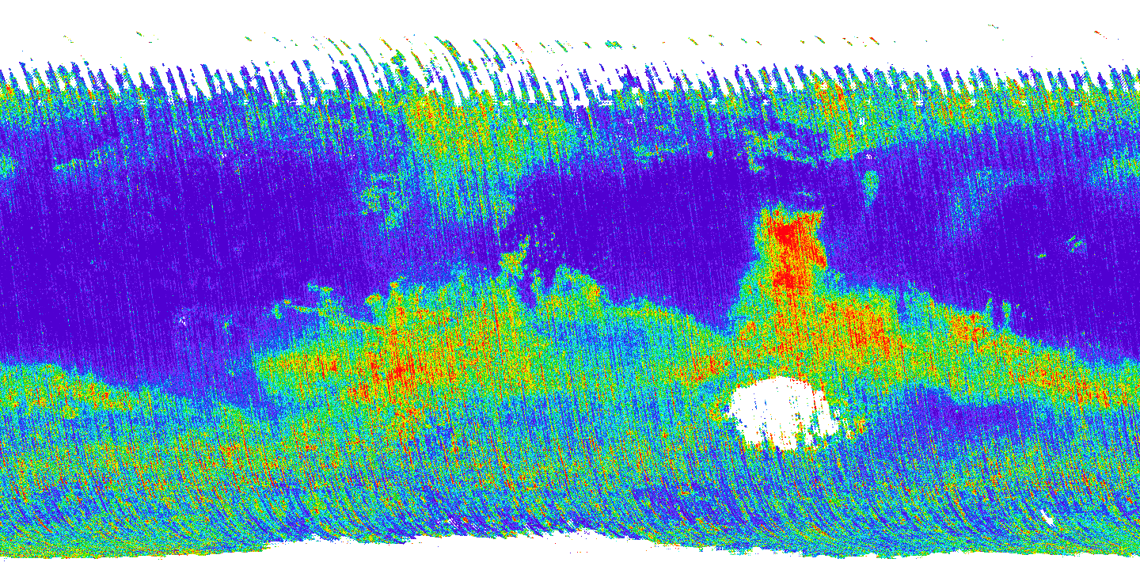
minerals
SILICATES
FELDSPAR
PLAGIOCLASE

Slide 9
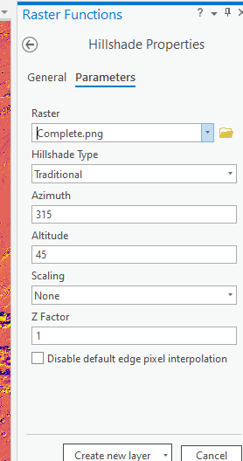
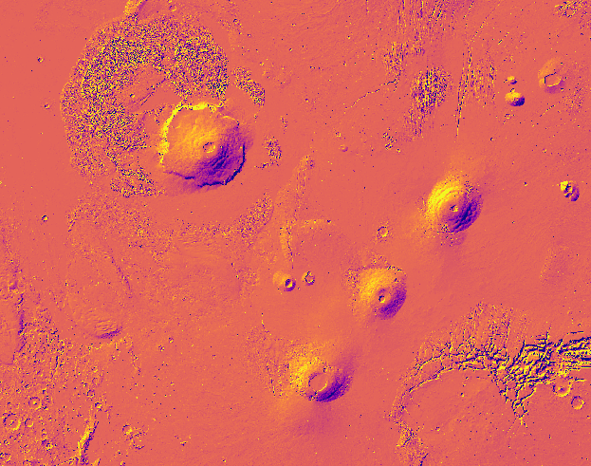
Raster operation : Hillshade

Slide 10
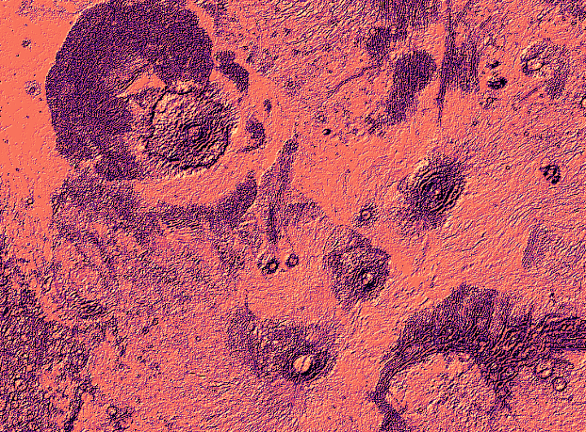
Satellite view
Actual relief

Slide 11
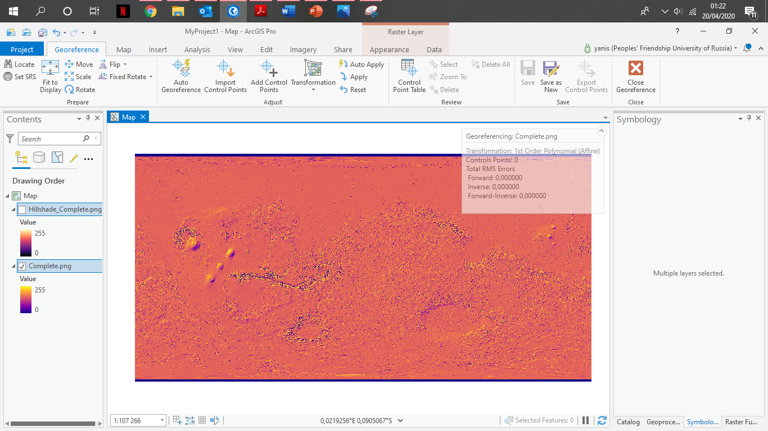
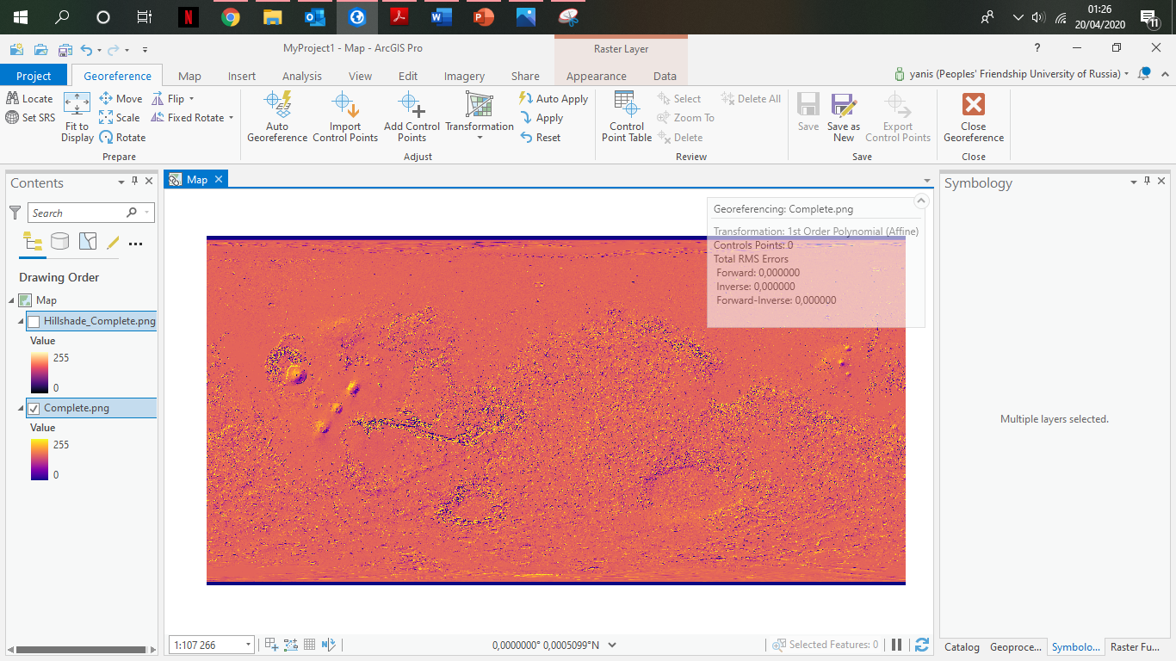

Raster operation : georeference

Slide 12
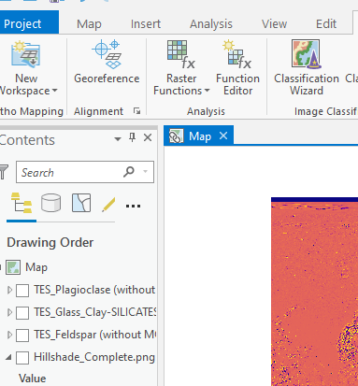
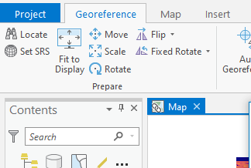
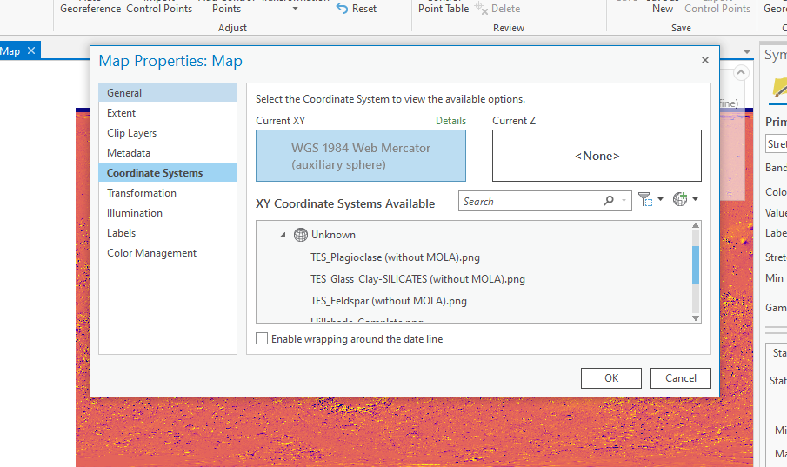

Slide 13
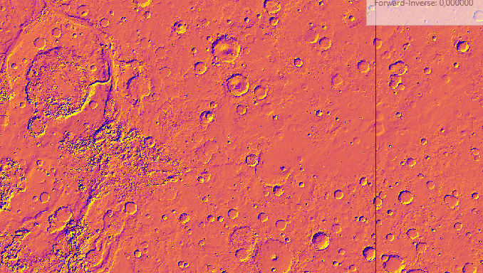
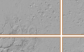
Raster operation : georeference
So we need to georeference the map in a better way

Slide 14
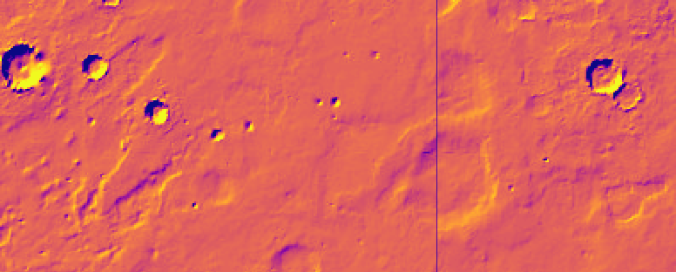
Edges of previous tiles, set to x=0 and y=0

Slide 15
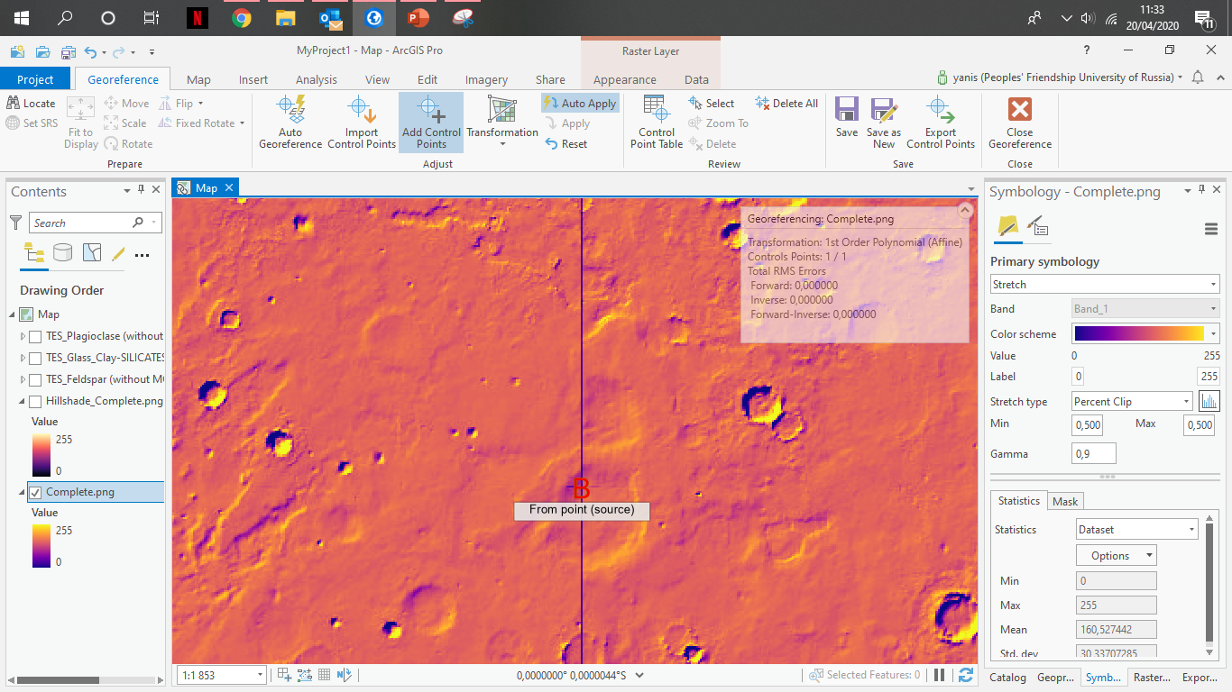
Now centered

Slide 16
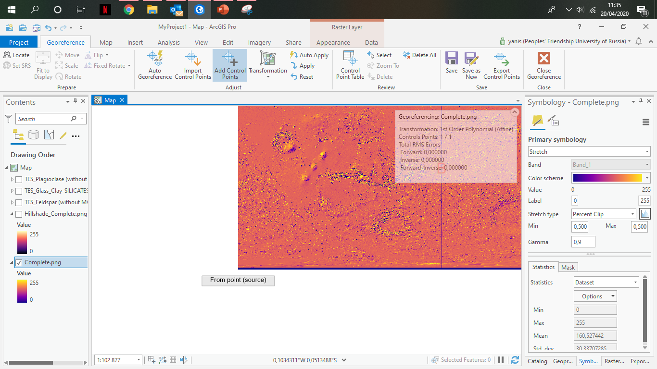
Far South-West, should be -90°S and -180°W

Slide 17
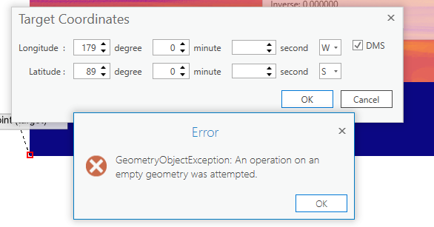
So, let’s consider this fix for the moment

Slide 18
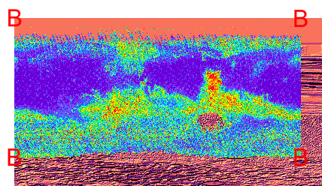
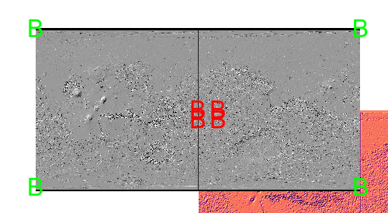
Same for the mineral's layers

Slide 19
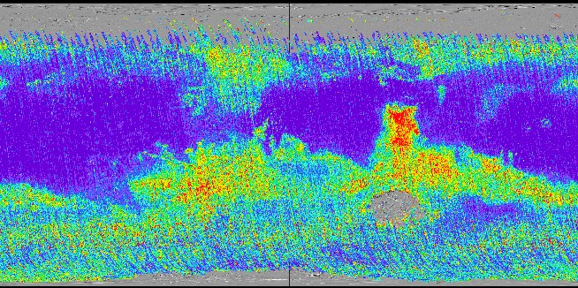
PLAGIOCLASE
Georeferenced

Slide 20
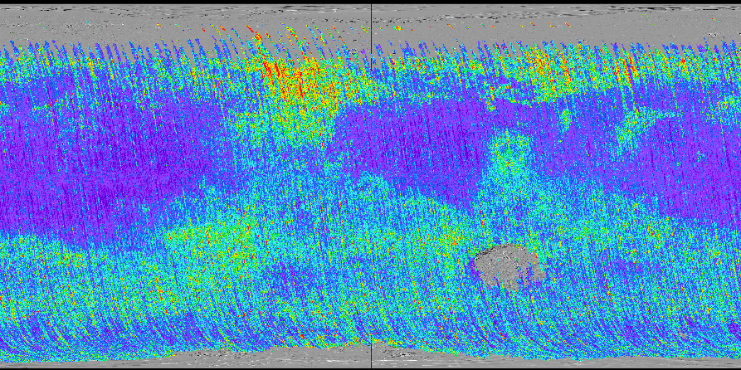
Exact same process for SILICATES
SILICATES
Georeferenced

Slide 21
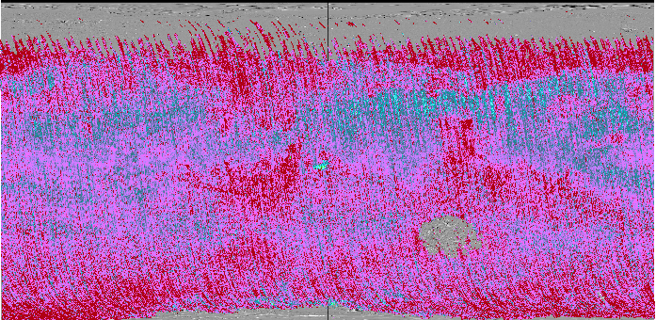
Exact same process for FELDSPAR
FELDSPAR
Georeferenced

Slide 22
Next step : mineral preference of life
Ex : 0,6
Ex : 0,25
SFP map
Ex : 0,15

